Slide 1

Domain: MATLAB
Technology: COMMUNICATION
AN IMPROVED ADAPTIVE BEAMFORMING ALGORITHM FOR 5G INTERFERENCE-COEXISTENCE COMMUNICATION

Slide 2
Index
Abstract
Introduction
Literature review
Existing Method
Disadvantages
Proposed method
Advantages
Applications
Hardware and Software Requirements
Results
Conclusion
References

Slide 3
Abstract
Multiple wireless systems coexisting in a 5G network might produce interference in the same frequency band, degrading the received signal's performance. In this paper, a novel algorithm is proposed in antenna array processing to handle interference-coexistence communication. We adopt a linear filter which is called Linearly Constrained Minimum Variance (LCMV) filter. We impose a log-sum penalty on the coefficients and add it to the cost function based on classic singly linearly constrained least mean square (LC-LMS). The iterative formula for filter weights is derived. We demonstrate that the new method's convergence rate is faster than the traditional one using simulations in an antenna environment with a signal of interest, noise, and interferences. Furthermore, the proposed method's mean-square-error (MSE) is confirmed. Our technique has a lower MSE than the classic LC-LMS algorithm, according to the findings of the experiments. The suggested adaptive beam forming approach can be used in a 5G system to deal with signal and interference coexistence.
.

Slide 4
Introduction:
The deployment and commercial operation of 5G systems are speeding up to meet the anticipated demands of next decade in data transmission. 5G networks are emerging intelligent systems which involve the application of advanced signal processing ,D2D , internet of things (IOT), edge computing , and wireless access technologies that have drawn much attention in recent years. In a 5G network, coexistence of multiple wireless systems can cause interference in the same frequency band and deteriorate the received signal. The anti-interference communication will still play an important role in the network. The adaptive beam forming technology has always been an import part in antenna processing to handle interference problem. The direction information is added into the transmitted signal with the technology and then the mixed signal, including signal of interest(SOI), interferences and noise, is received at receive end. Actually, SOI have different Direction of Arrival(DOA) compared with interferences. Adaptive algorithms ensure to produce null points towards the directions of interferences while maintain the gain of SOI.

Slide 5
Literature review:
S. NO | Journal Type with year | Authors | Title | Outcomes
1 | IEICE Trans. Commun., vol. E101-B, no. 4, pp. 1108–1115, Apr. 2018. | S. Wang, Y. Wang, B. Xu, Y. Li, and W. | “Capacity of two-way in-band full-duplex relaying with imperfect channel state information” | Studied about IBFD and half-duplex modes
2 | IEEE Trans. on Veh. Technol., | Z. Zhao, S. Bu, T. Zhao, Z. Yin, M. Peng, Z. Ding, and Tony Q. S. Quek | “On the design of computation offloading in fog radio access networks” | Studied about enlarge the performance gains of the NOMA-MC scheme
3 | IEEE Trans. Speech Audio Process., vol. 8, pp. 508C- 518, 2000. | D.L. Duttweiler | “Proportionate normalized least-mean squares adaptation in echo cancelers” | Studied about LEACH outperforms static clustering algorithms
4 | Proceeding of the IEEE International Conference on Acoustics, Speech and Signal Processing, 2009, pp. 3125–3128 | Y. Chen,Y. Gu,and A. O. Hero | “Sparse lms for system identification” | Studied about the RZA-LMS
5 | J. Fourier Anal. Appl.. | E. J. Cand‘ es, M. Wakin, and S. Boyd, | “Enhancing sparsity by reweighted l1 minimization” | Studied about a Compressive Sensing

Slide 6
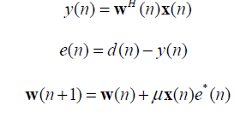
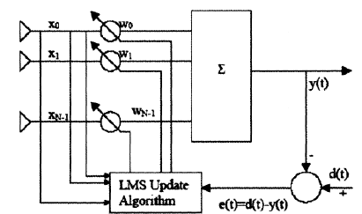
Existing method:
The Least Mean Square(LMS):
In adaptive filtering applications for modeling, equalization, control, echo cancellation, and beamforming, the widely used least-mean-square (LMS) algorithm has proven to be both a robust and easily-implemented method for on-line estimation of time-varying system parameters.
The LMS algorithm can be described by the following three equations,
Figure:LMS adaptive beamforming network

Slide 7




Cont..
Review of LC-LMS Algorithm:
LC-LMS algorithm was proposed to adjust coefficients of the array in real time. Here, we make an short review of the algorithm. Let y(n) be the observed output of antenna array
Then the desired output d(n) is expressed as In the above equation, wo is the optimal coefficient vector and N(n) is the observation AWGN with zero mean and variance. The LC-LMS filter aims to minimize the output power and maintain the response of the SOI. The optimization problem can be written as
The steepest descend method is used to get the solution of w(n)

Slide 8
Disadvantages in Existing methods:
1. The LMS algorithm has a slow convergence rate and its slow convergence presents an acquisition and tracking problem for cellular systems.
2.LC-LMS algorithm is not effective in the case of convergence rate
3. LC-LMS algorithm is also not effective in the case of steady state.

Slide 9
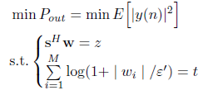

Proposed method:
On the basis of traditional ,singly linearly constrained least mean square (LC-LMS), we introduce a log-sum penalty on the coefficients and add it into the cost function. We derive the iterative formula of filter weights. By simulations in antenna environment with signal of interest, noise and interferences. In this part, we give the specific derivations of the new algorithm. The newly proposed algorithm adds log-sum penalty to the object function on the basis of LC-LMS. The optimization problem is expressed as follows
Similarly, through steepest descend method, we get

Slide 10
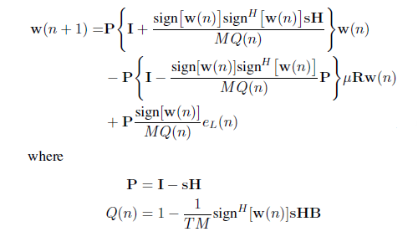
Proposed method:
Here, we use modulus value of coefficient w(n) to show the convergence rate. Steady state is characterized by MSE.

Slide 11
Advantages of Proposed method:
1. Log Sum LC-LMS algorithm has fast convergence rate.
2. Log Sum LC-LMS algorithm has lower MSE(Mean Square Error).
3. Log Sum LC-LMS algorithm is well suited for interference-coexistence communication.

Slide 12
Applications:
1 Applied in 5G system.
2. System Identification.
3.Inverse Modeling.
4.Prediction.
5.Echo Cancellation.

Slide 13
Hardware and Software Requirements:
Hardware & Software Requirements:
Software: Matlab R2018a.
Hardware:
Operating Systems:
• Windows 10
• Windows 7 Service Pack 1
• Windows Server 2019
• Windows Server 2016
Processors:
Minimum: Any Intel or AMD x86-64 processor
Recommended: Any Intel or AMD x86-64 processor with four logical cores and AVX2 instruction set support
Disk:
Minimum: 2.9 GB of HDD space for MATLAB only, 5-8 GB for a typical installation
Recommended: An SSD is recommended a full installation of all Math Works products may take up to 29 GB of disk space
RAM:
Minimum: 4 GB
Recommended: 8 GB

Slide 14
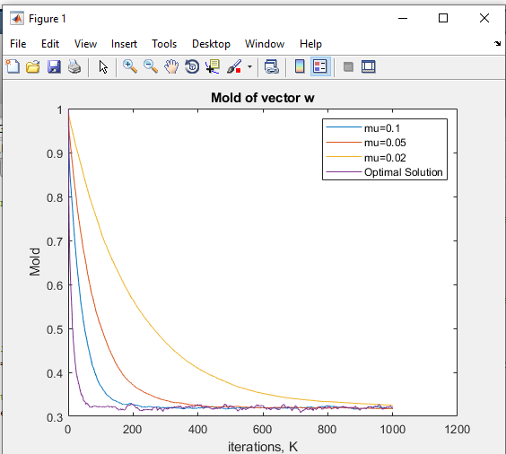
Results and Discussions:
Figure :Convergence Rate with different mu

Slide 15
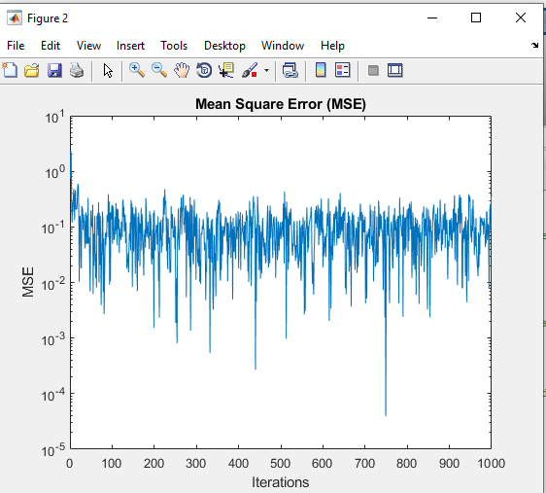
Results and Discussions:
Figure :Mean Square Error with M=4

Slide 16
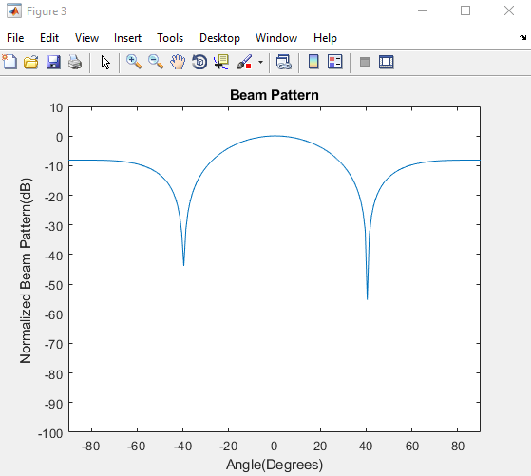
Results and Discussions:
Figure :Beam pattern

Slide 17
CONCLUSION:
We proposed a new algorithm based on the LC-LMS. We add log-sum penalty to the object function and give theoretical analysis step by step until derive the final formula. Then experiments are carried out on Matlab platform. The first experiment aims to compare the newly proposed algorithm with LC LMS in convergence rate and steady state. The results prove the effectiveness and superiority of the new method. In the second experiment, we analyze the factors that may affect the performance of the method. We can see that the choice of parameter t determines the algorithm performance, so t should be set properly. Finally, we make a comparison in beam pattern. The log-sum LC-LMS has the same performance as LC-LMS, or better.

Slide 18
References:
[1] S. Wang, Y. Wang, B. Xu, Y. Li, and W. Xu, “Capacity of two-way in-band full-duplex relaying with imperfect channel state information,” IEICE Trans. Commun., vol. E101-B, no. 4, pp. 1108–1115, Apr. 2018.
[2] S. Wang, D. D Wang, C. Li, and W. B Xu. “Full Duplex AF and DF Relaying Under Channel Estimation Errors for V2V Communications,” IEEE Access. vol. 6, pp. 65321-65332, Nov., 2018.
[3] Z. Zhao, S. Bu, T. Zhao, Z. Yin, M. Peng, Z. Ding, and Tony Q. S. Quek, “On the design of computation offloading in fog radio access networks,” to appear in IEEE Trans. on Veh. Technol., [Online] Availiable:https://ieeexplore.ieee.org/document/8730522.
[4] Z. Zhao, M. Xu, Yong Li, and M. Peng, “A non-orthogonal multiple access-based multicast scheme in wireless content caching networks,” IEEE J. Sel. Areas Commun., vol. 35, no. 12, pp. 2723–2735, July 2017.
[5] B. Widrow and S. D. Stearns, Adaptive Signal Processing, New Jersey: Prentice Hall, 1985.

